Slide 1

  Merchant Accounting System (MAS)

Slide 2


IST MAS is:
An automated, multi-currency solution to process all merchant payment and receivable transactions
Designed for:
  Merchant Acquirers
  Processors
  Merchants
Acquirer

Slide 3
Business Benefits
Flexible Financial Settlement methods
Flexible Transaction Pricing (incl. Promotional and Seasonal)
Supports a variety of merchant hierarchical structures and up to 99 levels
Multi-institution, currency, language
Infrastructure to support tax interface
Charge Fees based on billing level
Settlement Frequency
Split Payments to Reserve Accounts
Non-Qualification pricing
Rate Re-Assessment
Incentive Tiered Pricing with automatic new rate update
Dual entry General Ledger transactions
Fixed, Recurring, Minimum, Maximum, Penalty fees
Fast processing
Acquirer

Slide 4
System Features & Functions
System Overview
Merchant Setup
Automated Task Scheduler
File Recognition, Conversion & History
Suspended/Reject transaction Processing
Transaction Validation
Transaction Pricing & Posting
Payments processing
System File Balancing
Transaction Recovery
Acquirer

Slide 5
Features
Activity
Output
MAS
Payment
ACH
Wire
Other
Invoice
General Ledger
Reporting
Transaction Cleared
Exception Items
Authorization
Other
Remittance Entry

Slide 6
Interfaces
Merchant Deposit Capture System
Interchange Clearing and Settlement System
General Ledger System
Direct Deposit System
Proprietary Systems or File Formats*
Graphical User Interface (GUI)
Operator Access Entitlement Server
Acquirer

Slide 7
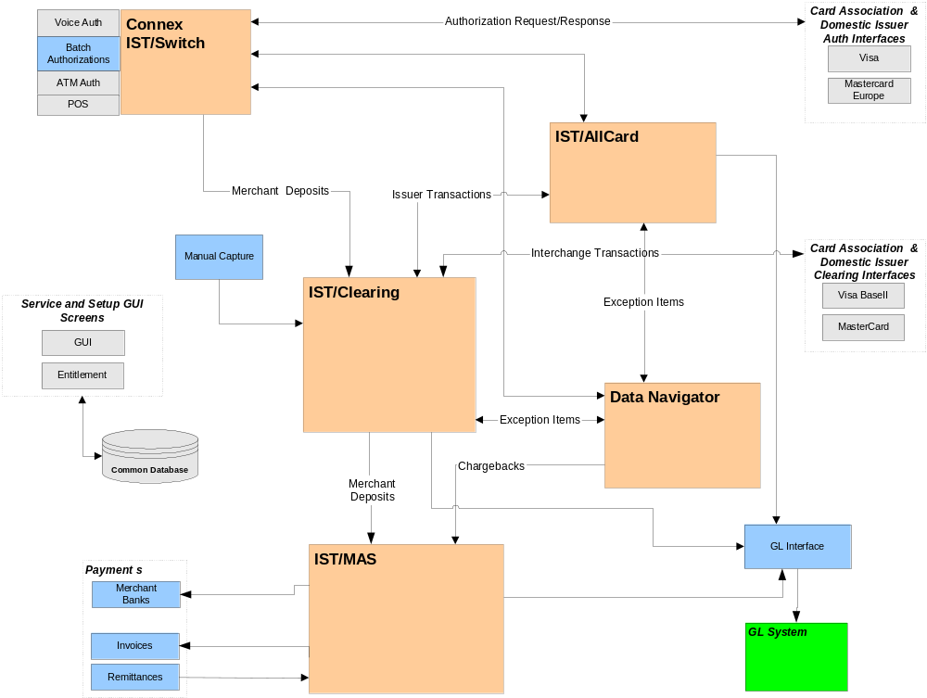
eFunds ePayment Products Solution Overview

Slide 8
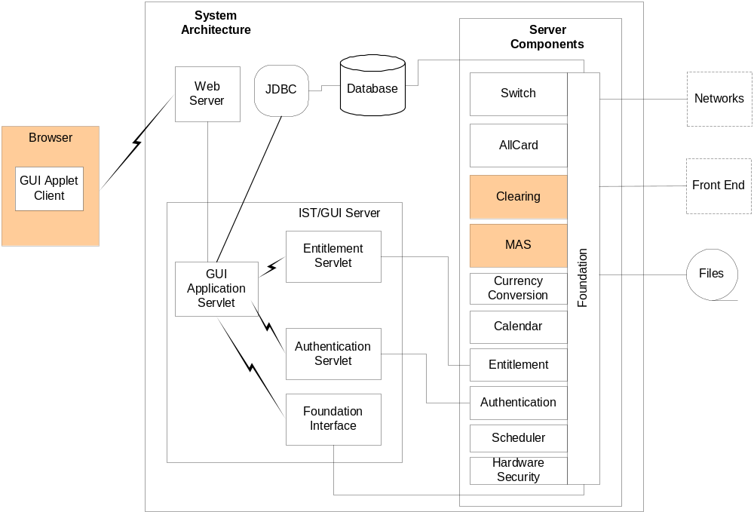
eFunds ePayments Solution Architecture

Slide 9
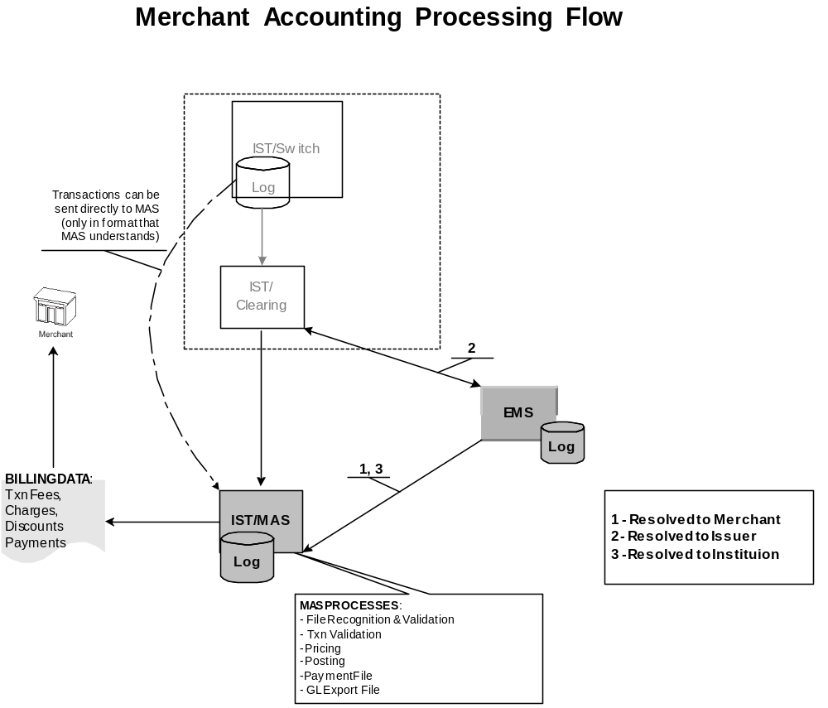

Slide 10
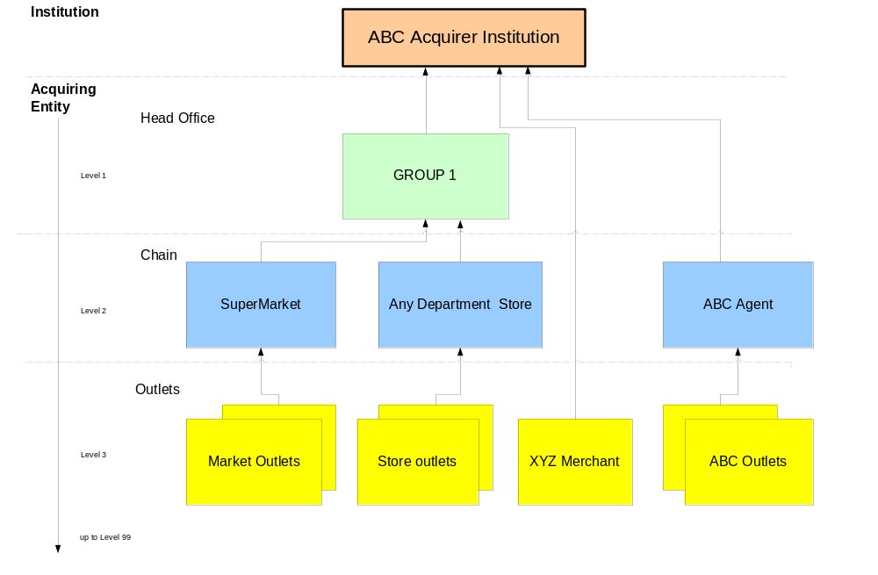
Sample Acquirer Hierarchy

Slide 11
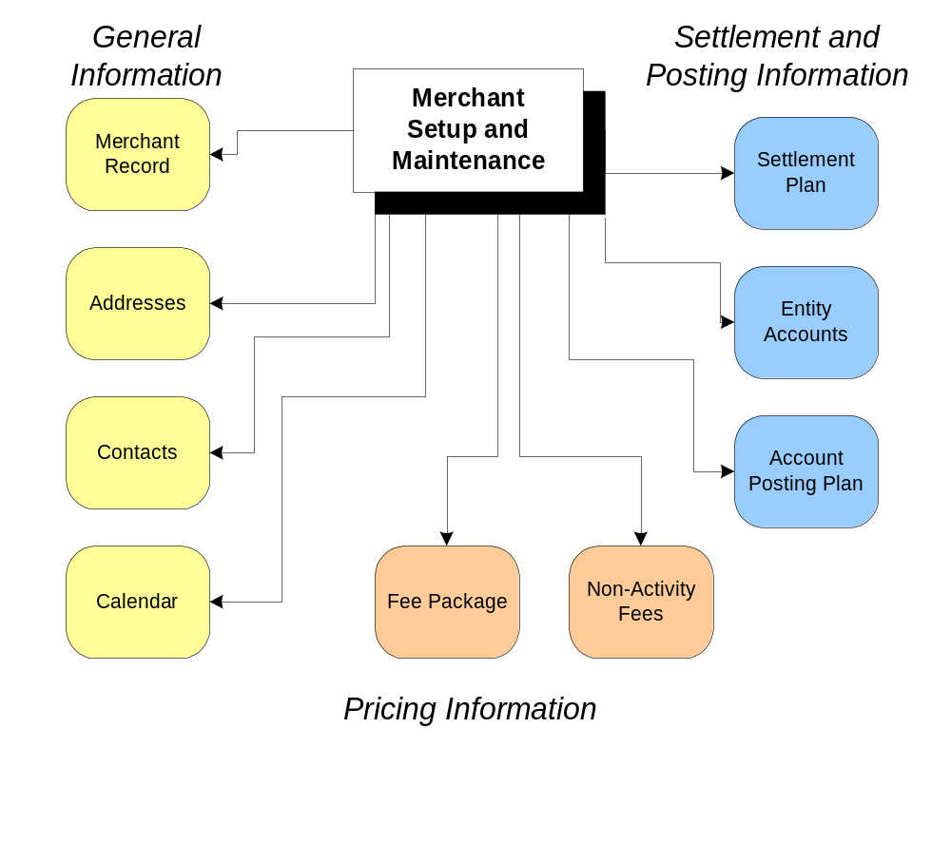
Merchant Setup and Maintenance

Slide 12
File Recognition
File recognition -determine if file name matches the expected file-types
File integrity - edit to determine if file structure is correct
File registration - record the presence of the file irrespective of its status
Activity Transactions supported in Files
  Merchant Deposits (Clearing System)
  Exception Items, Adjustments (EMS System)
  Authorizations (Authorization System)
  financial or non-financial transaction to be billed, settled or posted to GL
Acquirer

Slide 13
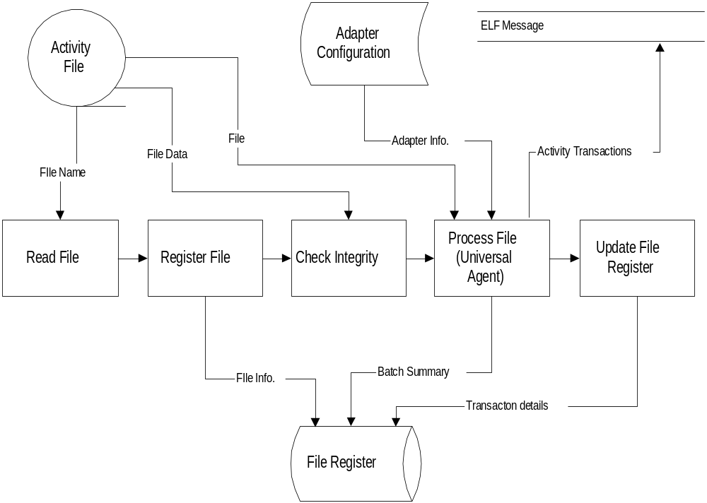
File Recognition Processing

Slide 14
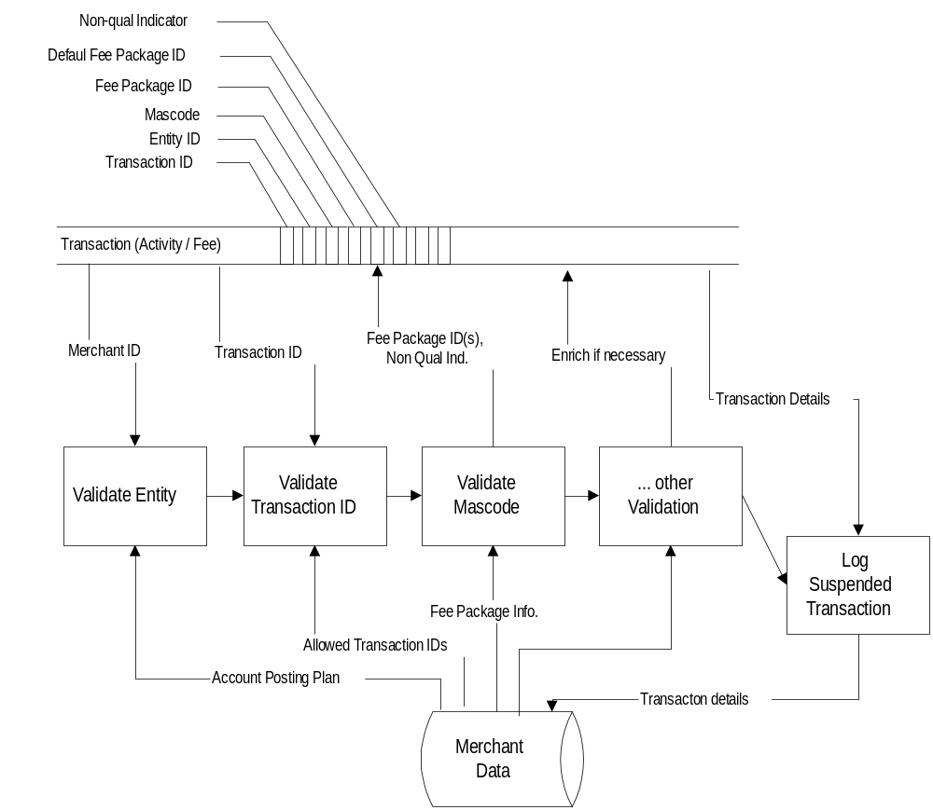
Transaction Validation
Suspend transaction levels
  File
  Batch
  Transaction
Validate
  Merchant ID
  Mascode
  Card scheme
  Fee package
  Settlement plan
  Account posting plan
  Posting Entity ID
  Settlement: Flag, Frequency, Date
  Payment Term

Slide 15
Pricing Package
Group sets of transactions and pricing levels into packages:
  Fee assessment on financial and non-financial transactions
  MASCode used to determine level of pricing
Pricing packages:
  Regular/Exclusive/Seasonal/Promotional
  Apply multiple pricing packages to the same merchant
  Reuse same pricing package to multiple merchants
Acquirer
TID
Card Scheme
MAS Code
Rate Percent
Rate per Item
Fee Package | TID | Card Scheme | MAS Code* | Rate %* | Rate per Item
501 | Sale | Visa | Paper | 1.25 | -
501 | Sale | Visa | No Auth | 1.15 | -
501 | Sale | Visa | Auth | 1.05 | -
* Equivalent to Card Association interchange qualification or proprietary
Notes:
The same fee packages to multiple merchant entities, with restrictions to tiers. – If shared vol. Count is based on volume of all merchants under the same fee package.

Slide 16
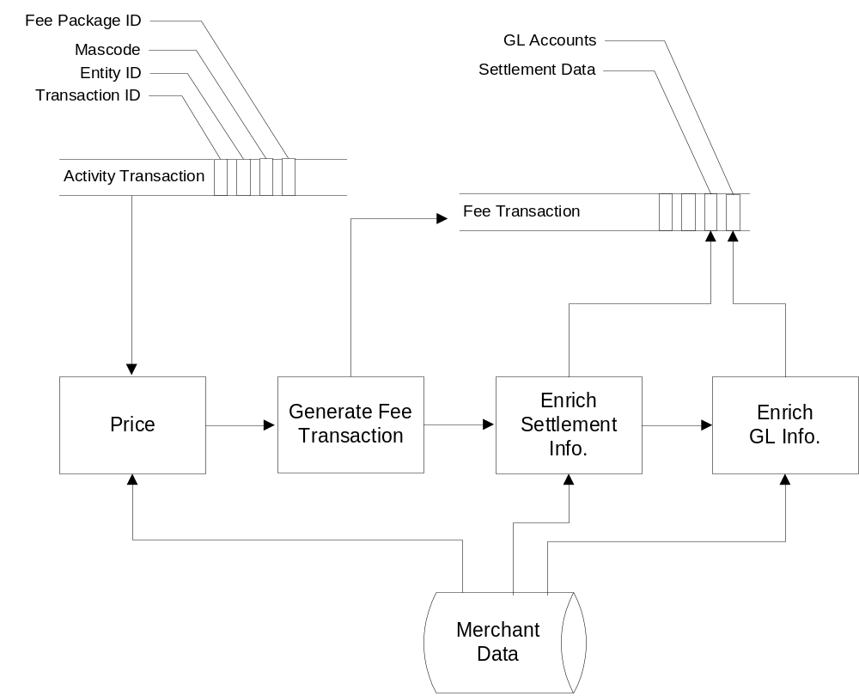
Transaction Pricing
Flexible Discount Pricing Models
Activity transactions using Pricing Packages
Rate Selection based on Transaction Type, Billing Code, Card Scheme
I.S.O. Billing (Revenue Sharing)
Split payments (reserve)
Non-Qualification Pricing
Tax calculation

Slide 17
Multiple Currency
Accept, Settle, Charge for transactions in any currency
Conversion plans
  Exchange rate effective date
  Conversion methods
  Rounding rules
  Gains losses due to rounding rules
Acquirer

Slide 18
Revenue Sharing
Share revenue among members of hierarchy
  Example:
  Merchant fee on $100.00 @ 2% = ($2.00)
  ISO receives 1% commission of fee amount charged ($0.02)
Acquirer

Slide 19
Settlement Plan
Specifies how each type of transaction is to be settled with a Merchant Entity:
TID
Card Scheme
Currency
Settlement Flag (y/n)
Settlement Frequency
Settlement delay factors
Posting Entity (e.g. Head Office on behalf of outlets)
Invoice due – payment term
Revenue Sharing
Reserve

Slide 20
Item Count Plans
Specifies how transaction counts and amounts are to be accumulated:
  By Merchant
  By TID
  By Card scheme
Totals are used to determine new rates based on a tier rate table.
Acquirer

Slide 21
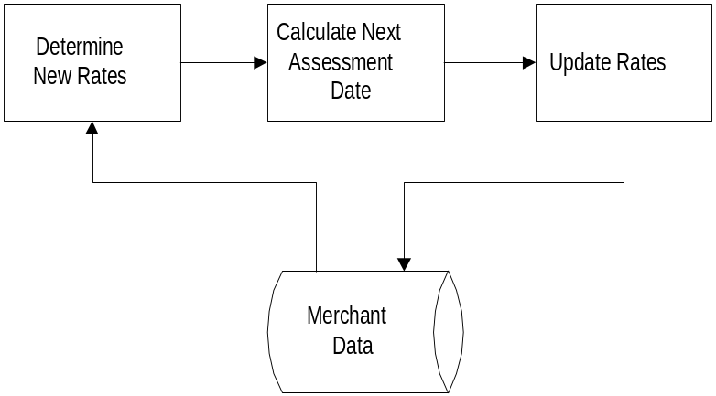
Rate Assessment
Rate reassessment
  Set future rate based on merchant’s performance
  Item Count Plan determines count combination
  New rates auto-set based on tier rate tables
Reassess by:
  Transaction volume
  Average transaction (ticket) amount
  Total transaction amount
Variable Pricing Adjustment
  Adjust fees for each cycle based on current rate
Sliding Scale Adjustment
  Adjust fees for each cycle based on current rate set by tier
Acquirer

Slide 22
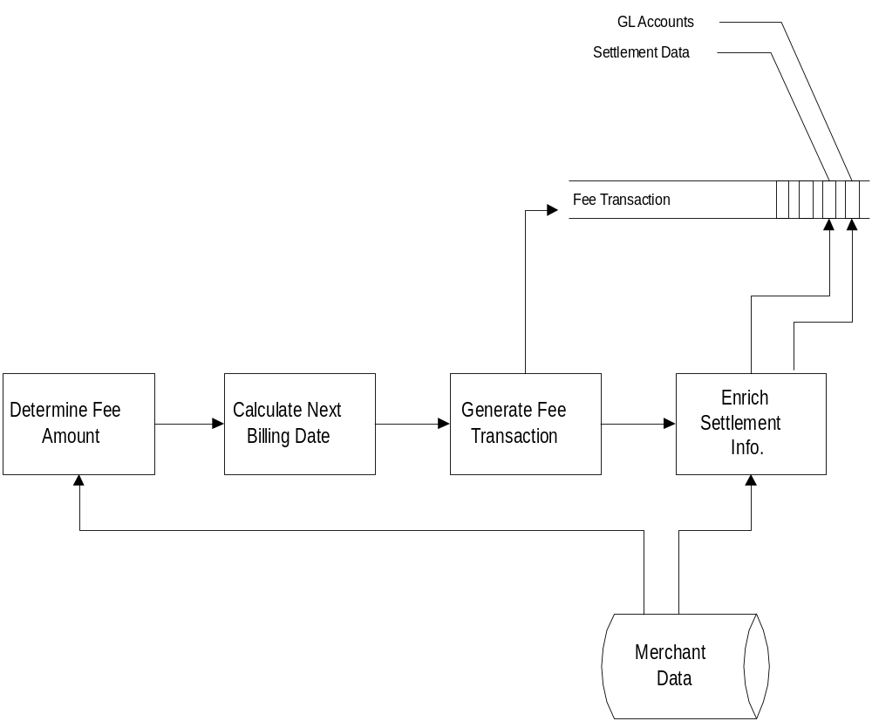
Non-activity Charges
Recurring fee (e.g monthly terminal rental)
Installment fees e.g (3 x 39,00Eur)
Penalty charges,
  if threshold volume not reached
Tiered pricing with minimum charges (current period)
Per item rate
  Maximum percent to volume – (charge for each trans. that exceeds threshold value)
Flat rate
  Maximum percent to volume –, (for example, $15 per Chargeback exceeding 1% of sales)
ACH, Wire Fee

Slide 23
Manual Transaction Processing
Adjustments
  GUI manual entry with free text description
  Imported through Activity Files
  Three types of Online Adjustments:
  Fee Adjustments
  Payment Adjustments
  Billing Requisition Adjustments
Acquirer

Slide 24
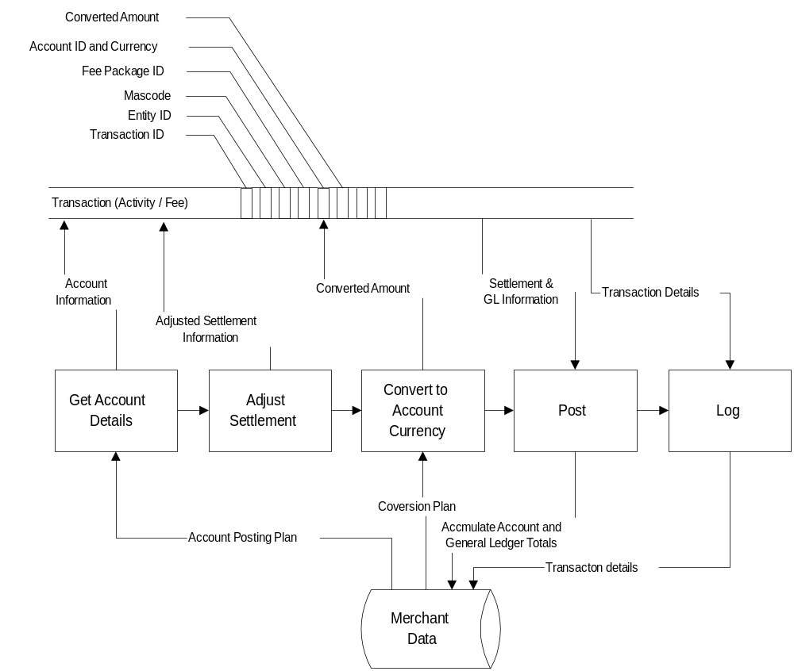
Transaction Billing
Currency conversion
Adjust settlement date
Accumulate account details
Accumulate GL
Log transaction details

Slide 25
Account Posting
TID
Card Scheme
Currency
Entity Account
Transaction Type (TID)
Card Scheme
Currency
Entity Account
All Deposits (Class)
Default
978
Account #1
Discount (Specific Transaction)
Default
978
Account #1
All Chargebacks (Class)
Default
978
Account #2
All Adjustments (Class)
Default
978
Account #2
Fees (Class = Fees)
Default
978
Account #3

Slide 26
Payment File Types
Generate Payment Files
  ACH, Proprietary
  Wire
  Invoice
  Check adjustments to merchant
Apply bank calendar to determine business day of destination for payment file delivery
Acquirer

Slide 27
Accounts Receivable
Invoice and Remittance Processing
  Fees not settled through the merchant’s DDA will be invoiced and aged
  Configurable Payment Terms
  Delinquency Cycles/Number of Cycles configurable
  Invoices not settled after a configurable time period may be treated as write-offs, and accounted for in a GL account
Acquirer

Slide 28
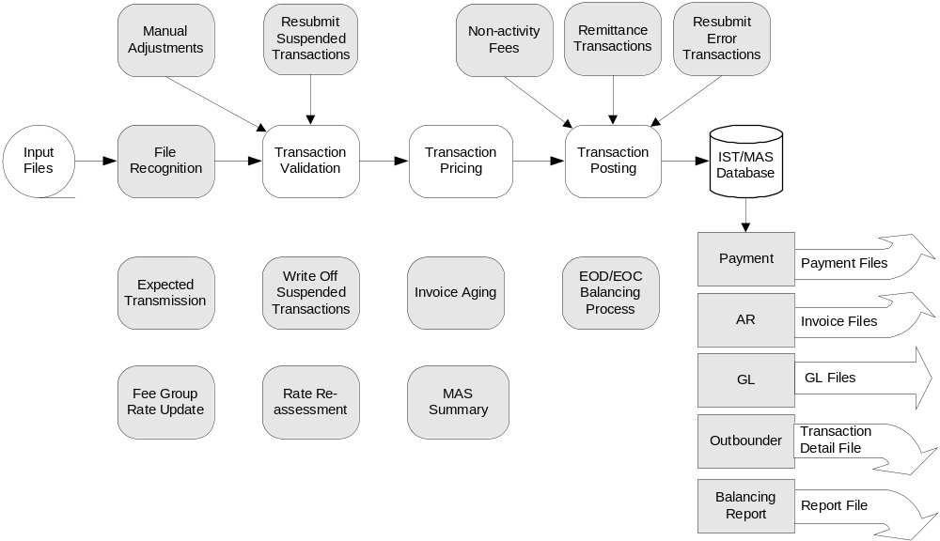
MAS System Overview
Define per process
Scheduler - Tasks
Daily, weekly, monthly
Time period/day
Exception day/time via Calendar
Notes:
Activity file recognition – the process that will detect the presence of an activity file and prepare it for processing.
Payment processing – the process that will produce payment files. ACH,
Invoicing – the process that will generate invoices.
Non-activity charges = Terminal, One-Time fee, Monthly Fee etc.
Rate re-assessment.

Slide 29
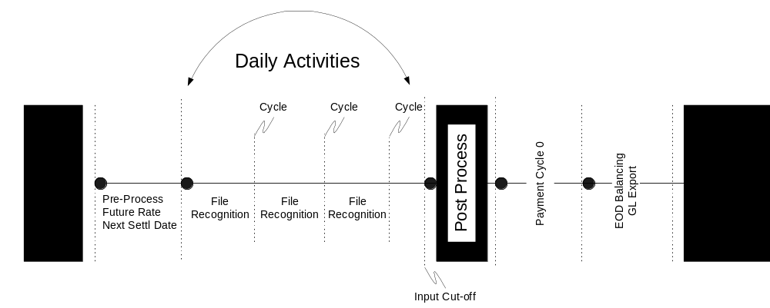
Daily System Processing

Slide 30
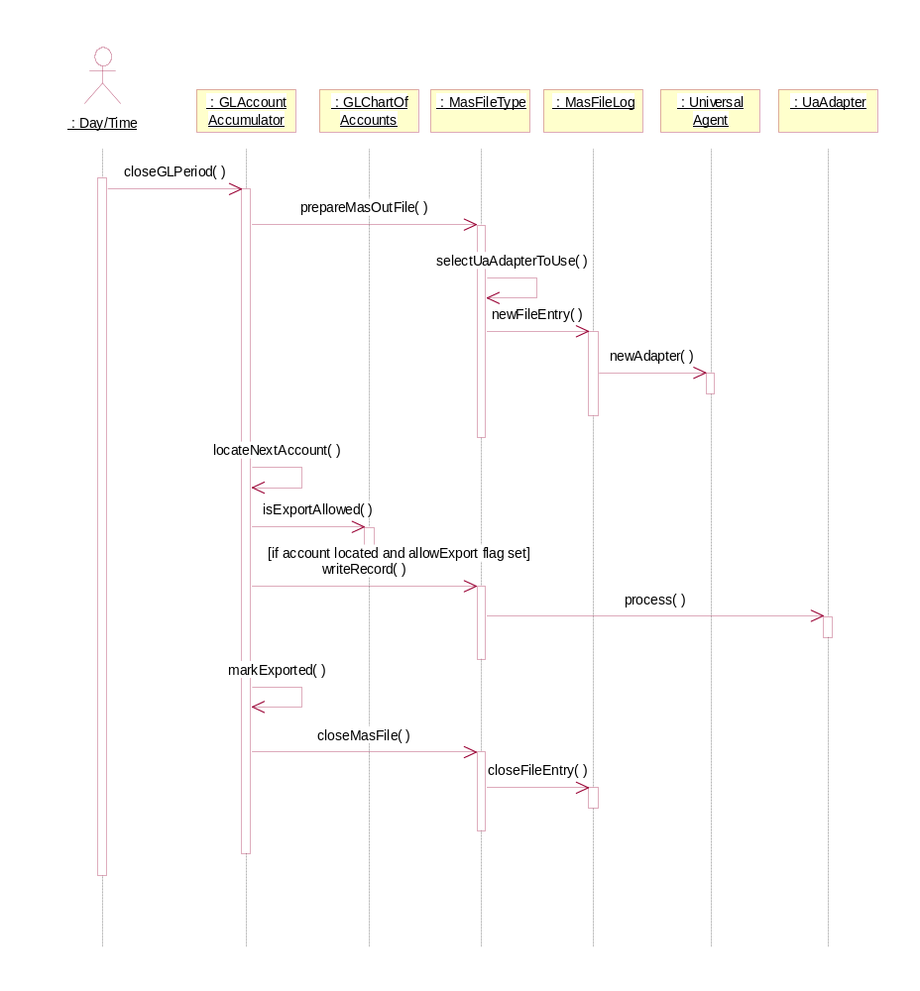
General Ledger
GUI inquiry report or data file
  Default File format supported
Flexible G/L account mapping
  Transaction Type
  Currency
  Card Type

Slide 31
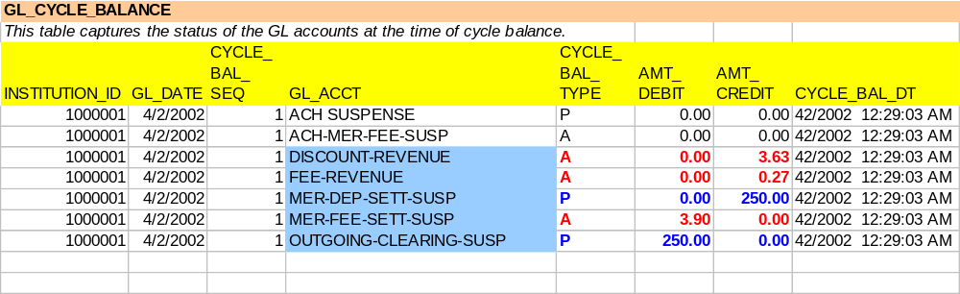
Sample GL Output

Slide 32
User Inquiry Functionality
Search by:
  merchant number and/or name
Online inquiry :
  Hierarchical Payments Summary by Merchant
  Merchant account set-up details
  Payment summaries and details
  Fees, adjustments, reject reports
  Deposit Information
  EOD (Balancing output)
Acquirer

Slide 33
Tools
UML (Unified Modeling Language)
  Rational Rose
C++
Java
Oasis Specific Tools
  Universal Agent (mapping)
  Transaction Vocabulary System
  Database Management (isolates App from DB)
  Mailbox
  Universal Database Model

Slide 34
GUI Architectural Std
Thin client display
  Workflow for multiple logical functions
    e.g.: Merchant Setup, Cardholder Application Processing
  Tight integration facilities for each subsystem
    Control
    Configuration
  Java implementation
    Localized client processing
    Java look and feel guidelines
  Multi-language, multi-byte
  Tightly coupled with entitlement svcs
  Reports available via thin client

Slide 35
Summary
Completely flexible merchant billing and settlement system based on Open Systems and a relational database
Scaleable
Built for today’s complex billing requirements
Easy, fast implementation of changes
Interfaces to internal and external systems
Multi-Institution and Multi-Currency

